Slide 1
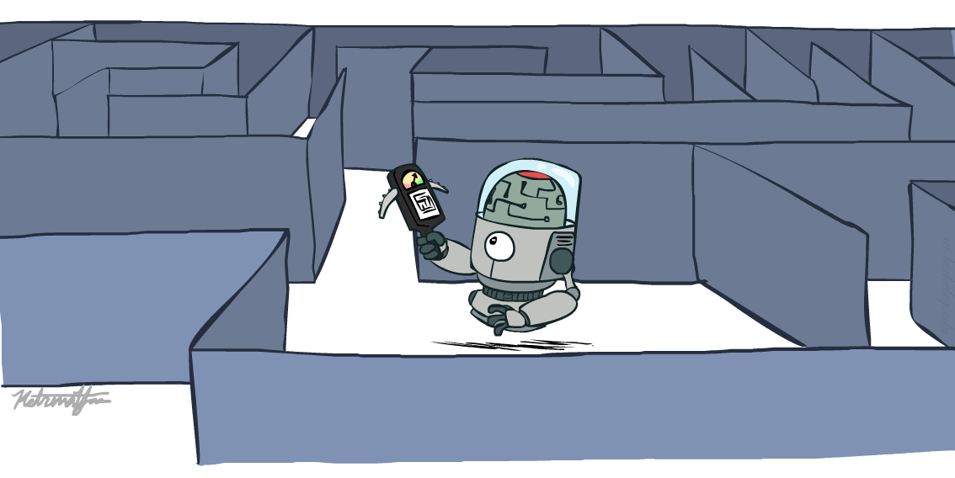
CS 188: Artificial Intelligence
Informed Search
Instructors: Dan Klein and Pieter Abbeel
University of California, Berkeley
[These slides were created by Dan Klein and Pieter Abbeel for CS188 Intro to AI at UC Berkeley. All CS188 materials are available at http://ai.berkeley.edu.]
Notes:
Please retain proper attribution, including the reference to ai.berkeley.edu. Thanks!

Slide 2

Today
Informed Search
  Heuristics
  Greedy Search
  A* Search
Graph Search
Memory Bounded Informed Search

Slide 3
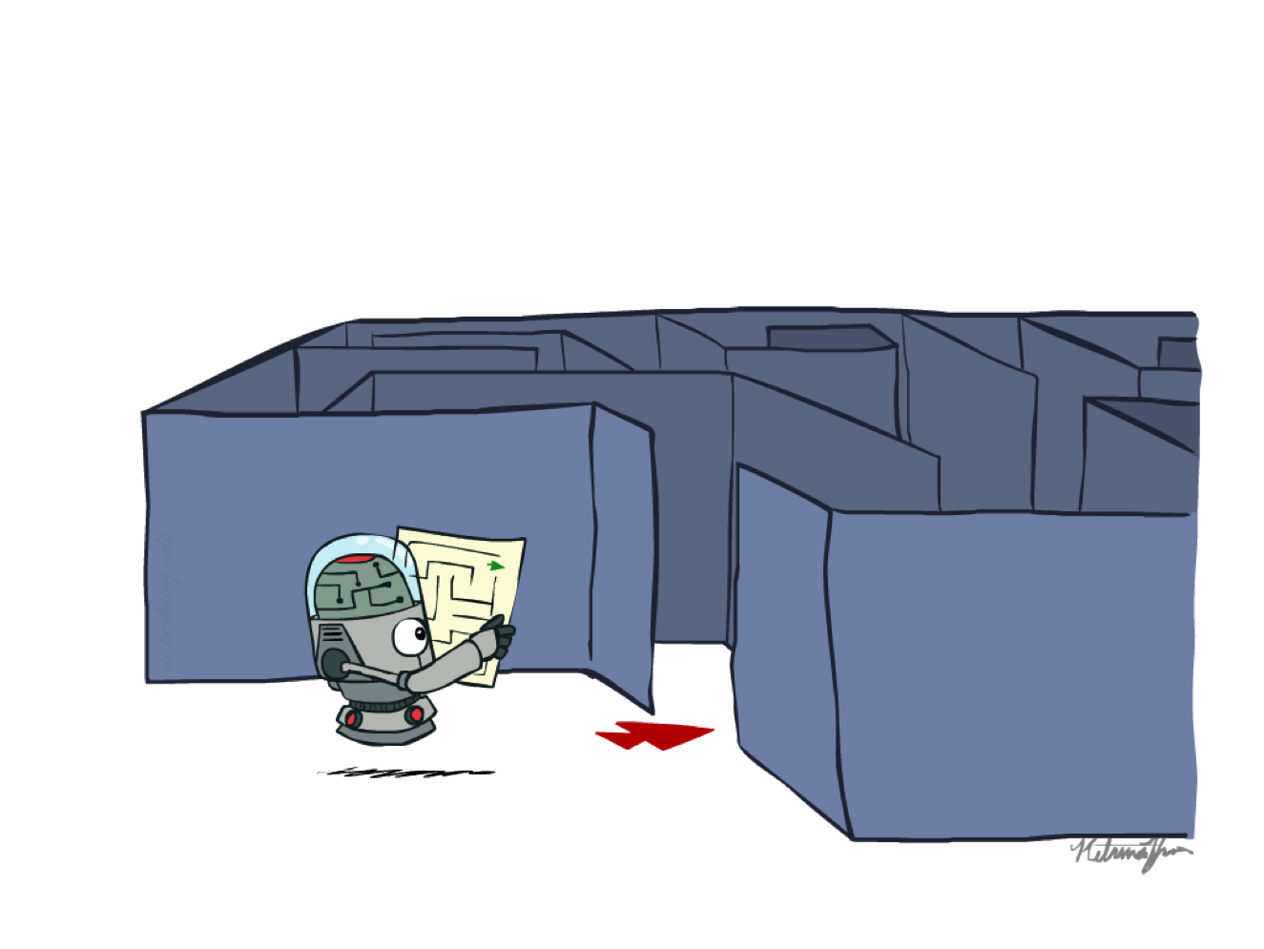
Recap: Search

Slide 4
Recap: Search
Search problem:
  States (configurations of the world)
  Actions and costs
  Successor function (world dynamics)
  Start state and goal test
Search tree:
  Nodes: represent plans for reaching states
  Plans have costs (sum of action costs)
Search algorithm:
  Systematically builds a search tree
  Chooses an ordering of the fringe (unexplored nodes)
  Optimal: finds least-cost plans

Slide 5
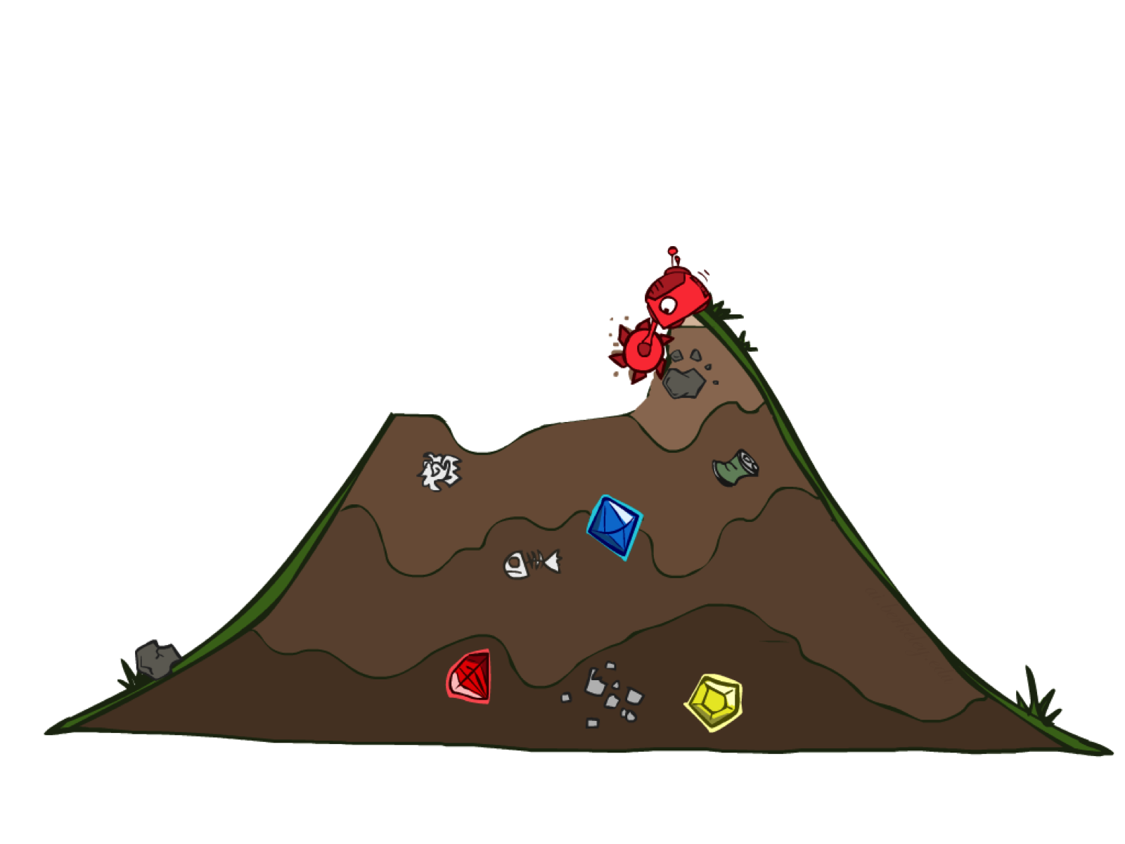
Uninformed Search

Slide 6
Uniform Cost Search
Strategy: expand lowest path cost
The good: UCS is complete and optimal!
The bad:
  Explores options in every “direction”
  No information about goal location
c ≤ 1
…
c ≤ 2
c ≤ 3
Start
Goal
[Demo: contours UCS empty (L3D1)]
[Demo: contours UCS pacman small maze (L3D3)]

Slide 7

Informed Search

Slide 8
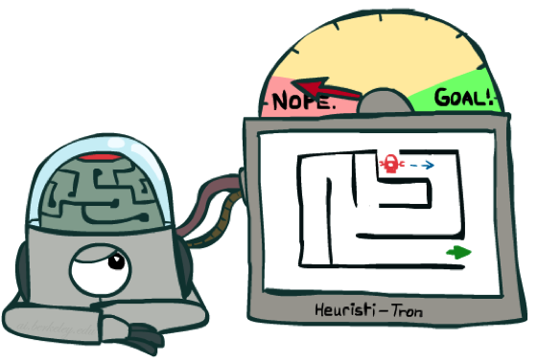
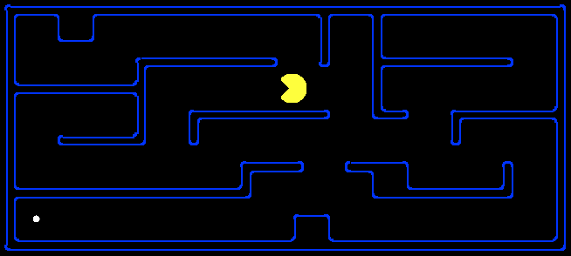
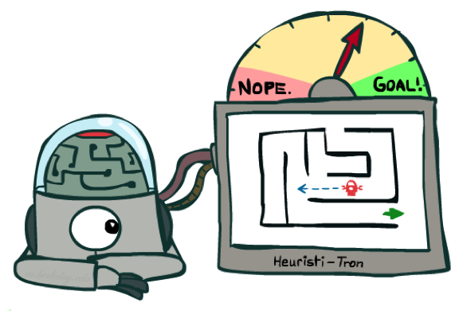
Search Heuristics
A heuristic is:
  A function that estimates how close a state is to a goal
  Designed for a particular search problem
  Examples: Manhattan distance, Euclidean distance for pathing
10
5
11.2

Slide 9
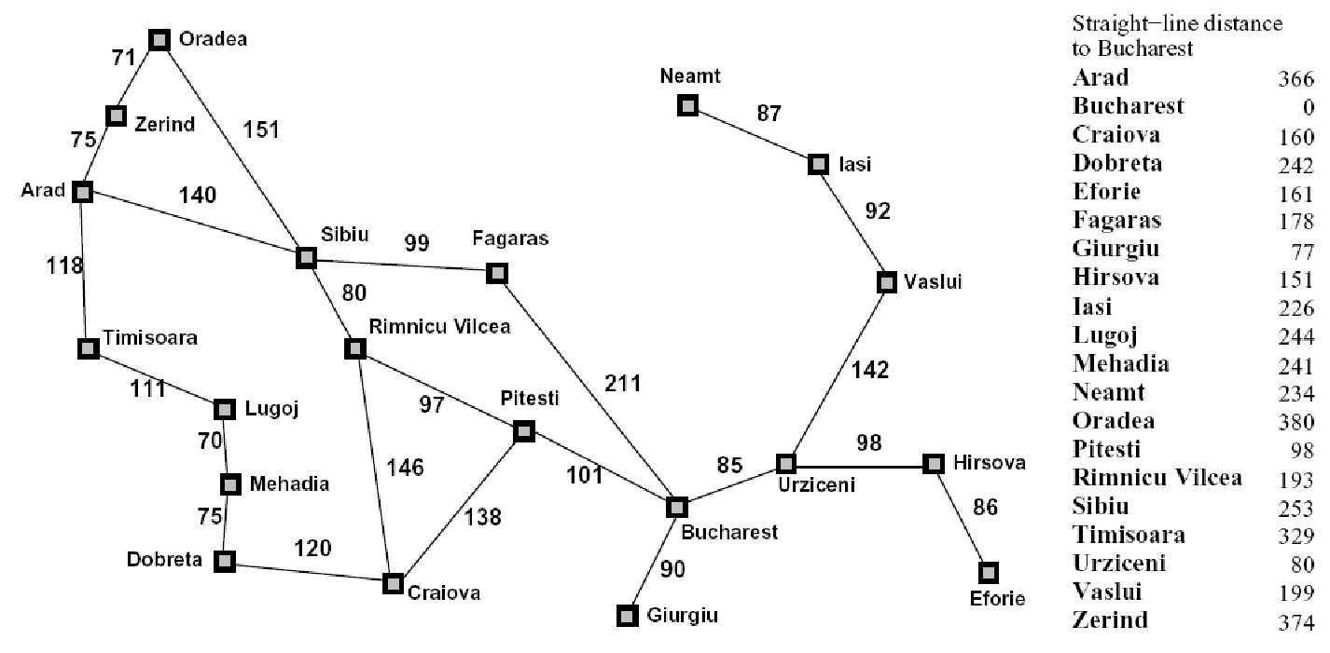
Example: Heuristic Function
h(x)

Slide 10
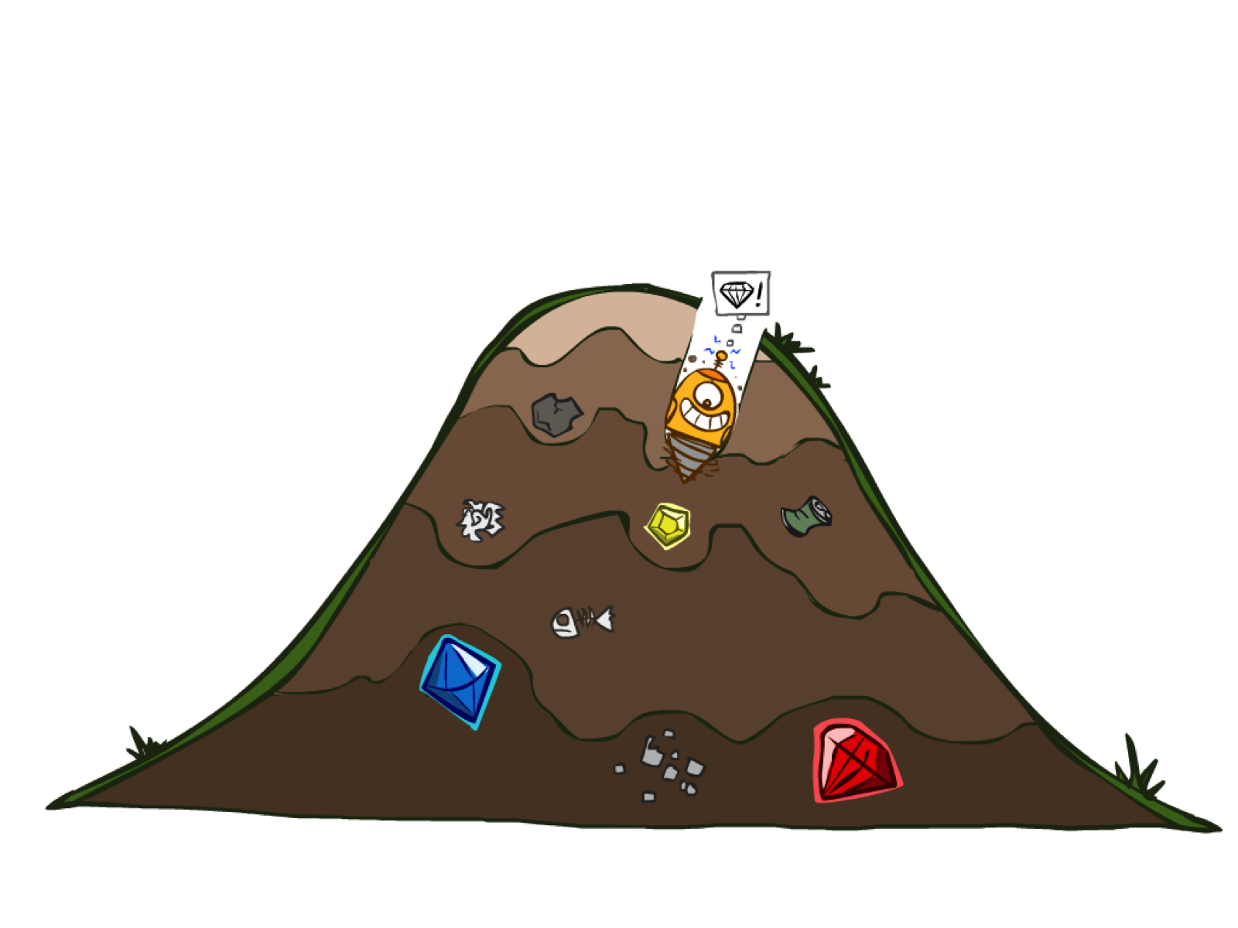
Greedy Search

Slide 11
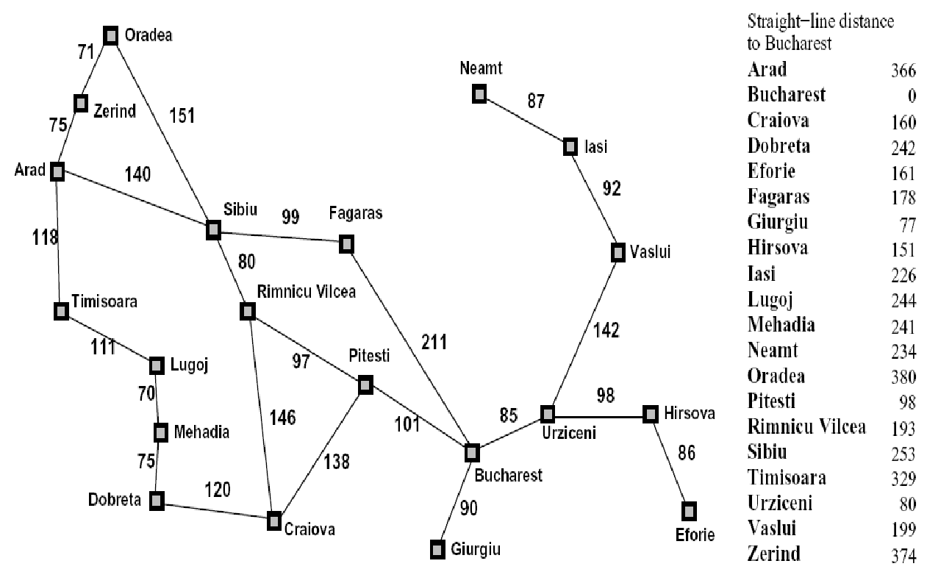

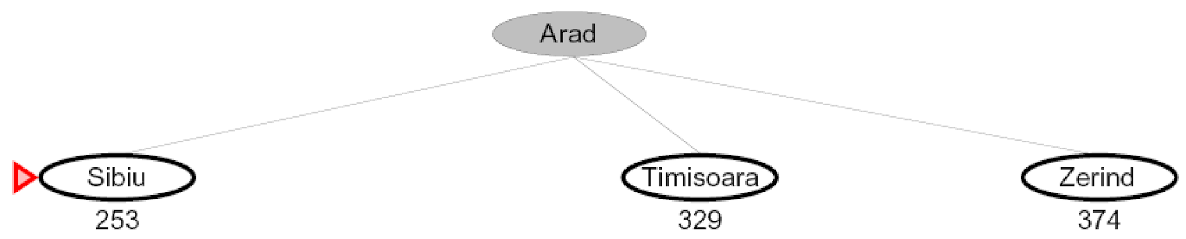
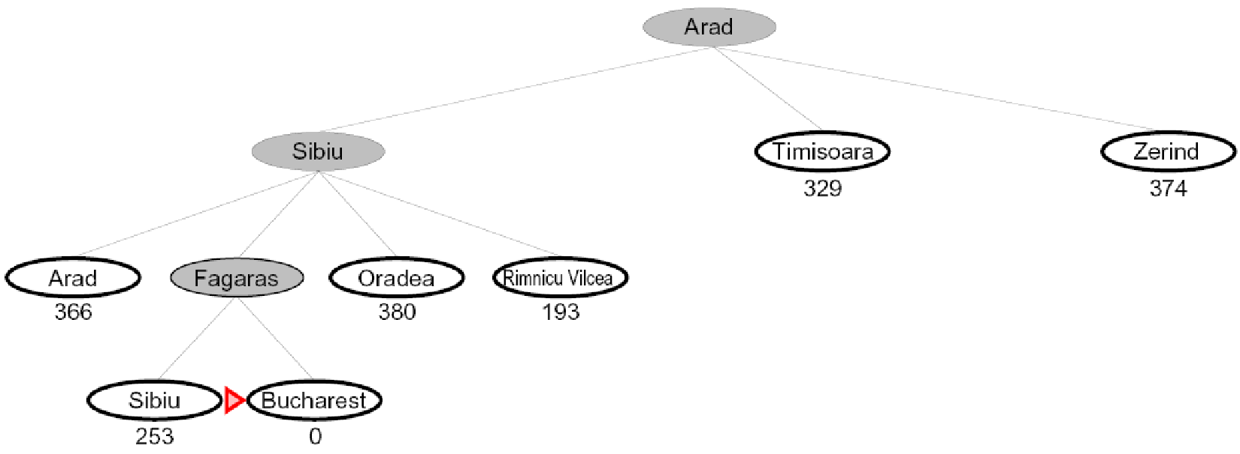
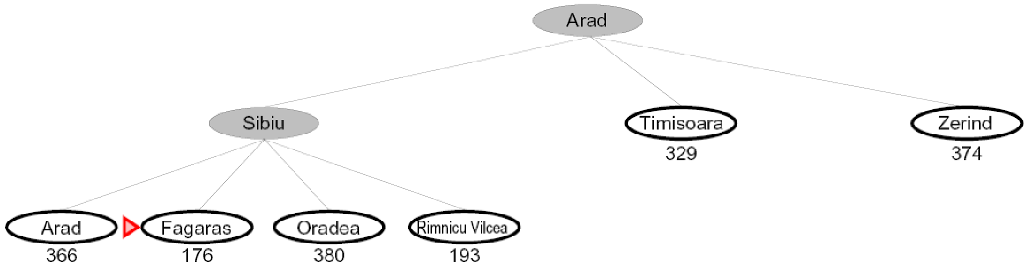

Greedy Search
Expand the node that seems closest…
What can go wrong?

Slide 12
Greedy Search
b
Strategy: expand a node that you think is closest to a goal state
  Heuristic: estimate of distance to nearest goal for each state
A common case:
  Best-first takes you straight to the (wrong) goal
Worst-case: like a badly-guided DFS
…
b
…
Notes:
For any search problem, you know the goal. Now, you have an idea of how far away you are from the goal.

Slide 13
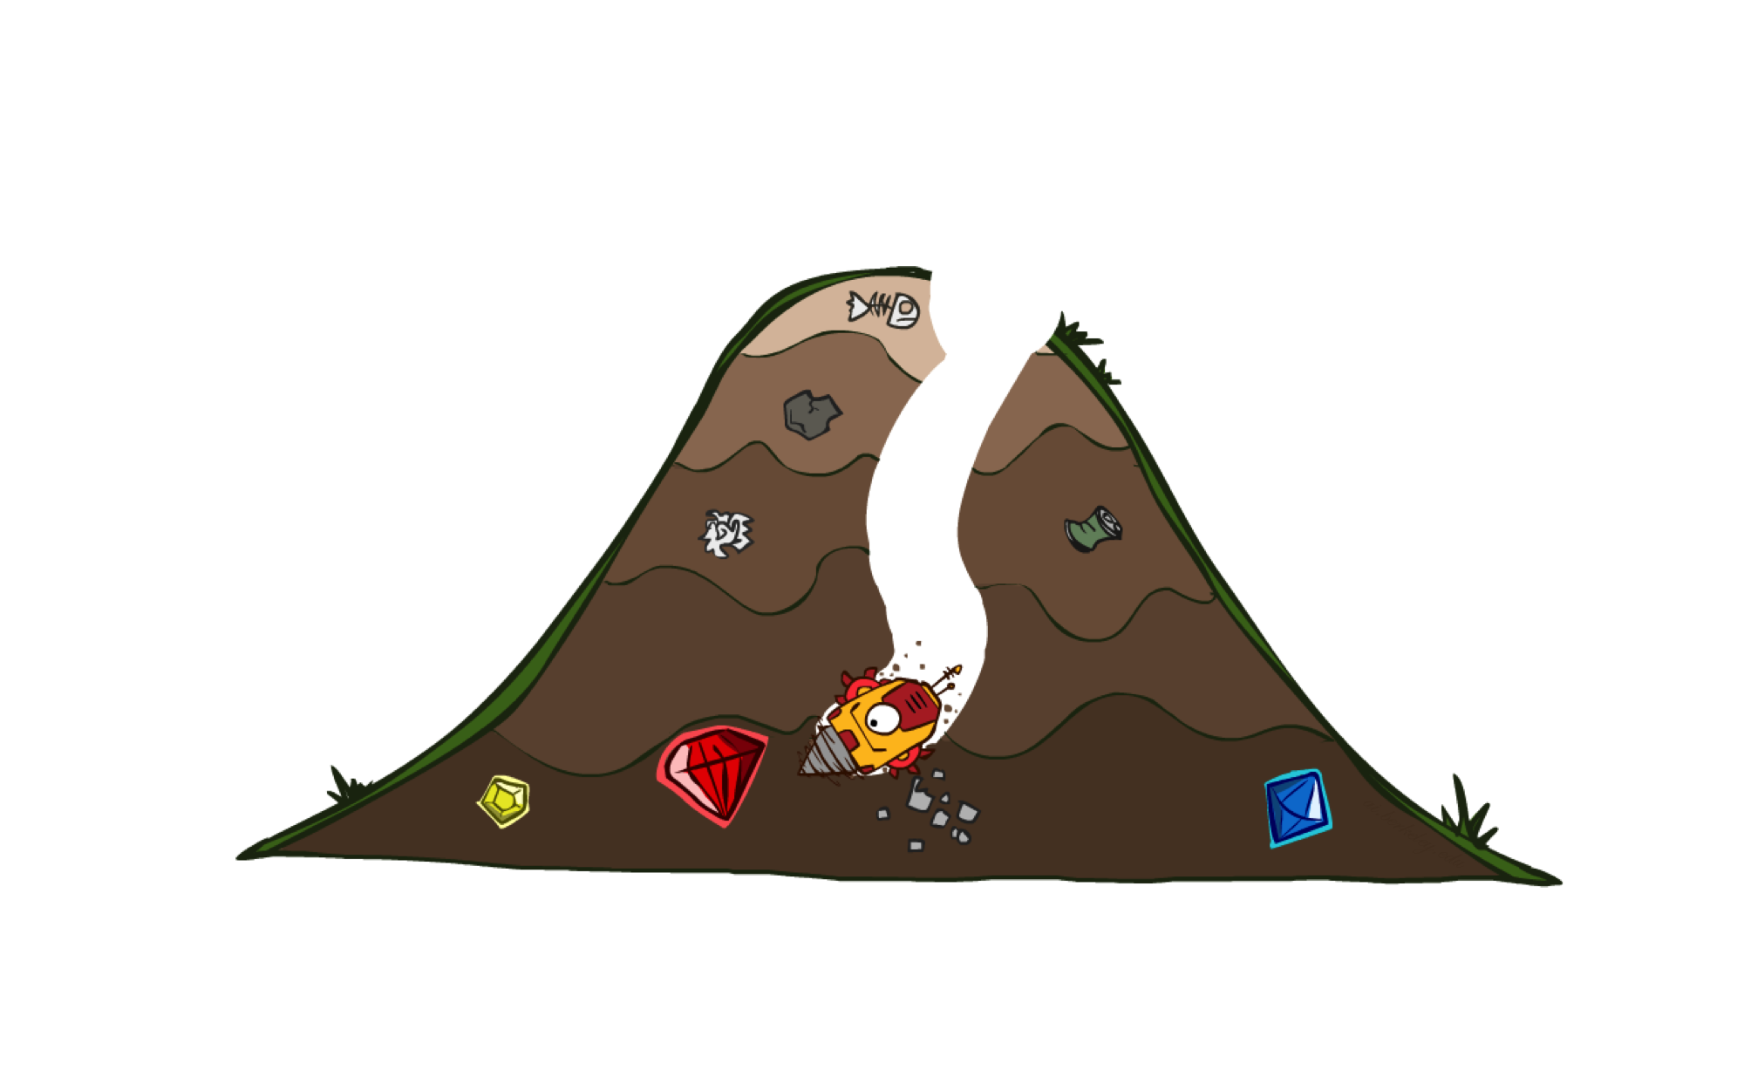
A* Search

Slide 14

A* Search
UCS
Greedy
A*
Notes:
Notes: these images licensed from iStockphoto for UC Berkeley use.

Slide 15
Combining UCS and Greedy
Uniform-cost orders by path cost, or backward cost g(n)
Greedy orders by goal proximity, or forward cost h(n)
A* Search orders by the sum: f(n) = g(n) + h(n)
8
g = 0 h=6
S
e
h=1
g = 1 h=5
a
1
1
3
2
g = 2 h=6
g = 9 h=1
S
a
d
G
b
d
g = 4 h=2
e
h=6
1
h=5
h=2
h=0
1
g = 3 h=7
g = 6 h=0
g = 10 h=2
c
b
c
G
d
h=7
h=6
g = 12 h=0
G
Example: Teg Grenager

Slide 16
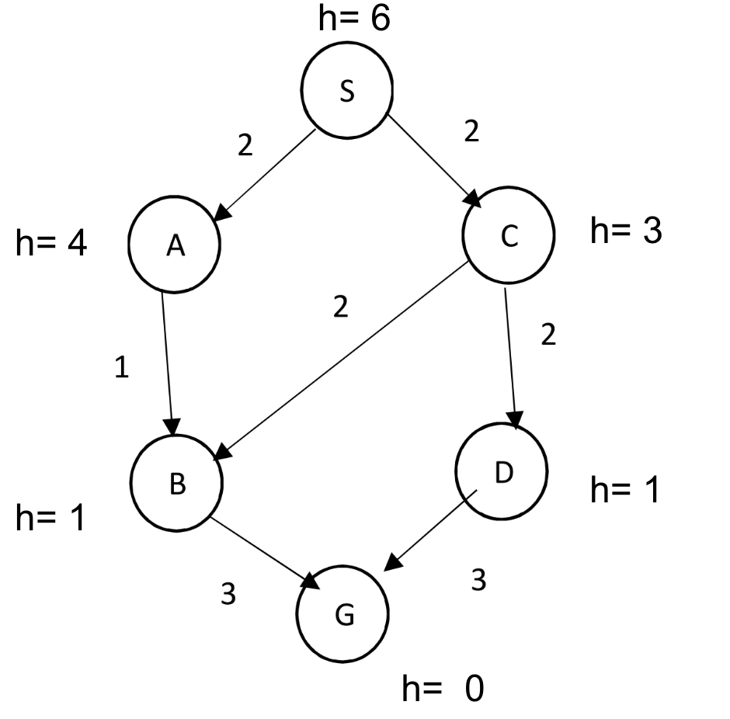
Example
Consider the following state space graph where S is the start state and G is the goal state. h represents the heuristic values of the states. Show the expansion path, solution path and the associated actual path cost for greedy best first search, A* tree search.

Slide 17
When should A* terminate?
Should we stop when we enqueue a goal?
No: only stop when we dequeue a goal
h = 2
A
2
2
S
h = 3
h = 0
G
2
B
3
h = 1

Slide 18
Is A* Optimal?
h = 6
1
A
3
S
h = 7
G
h = 0
5
What went wrong?
Actual bad goal cost < estimated good goal cost
We need estimates to be less than actual costs!

Slide 19
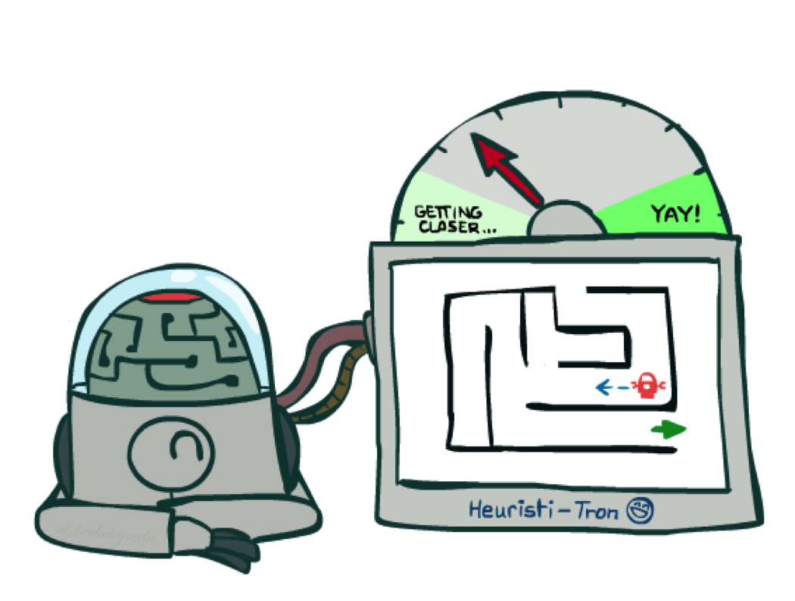
Admissible Heuristics

Slide 20
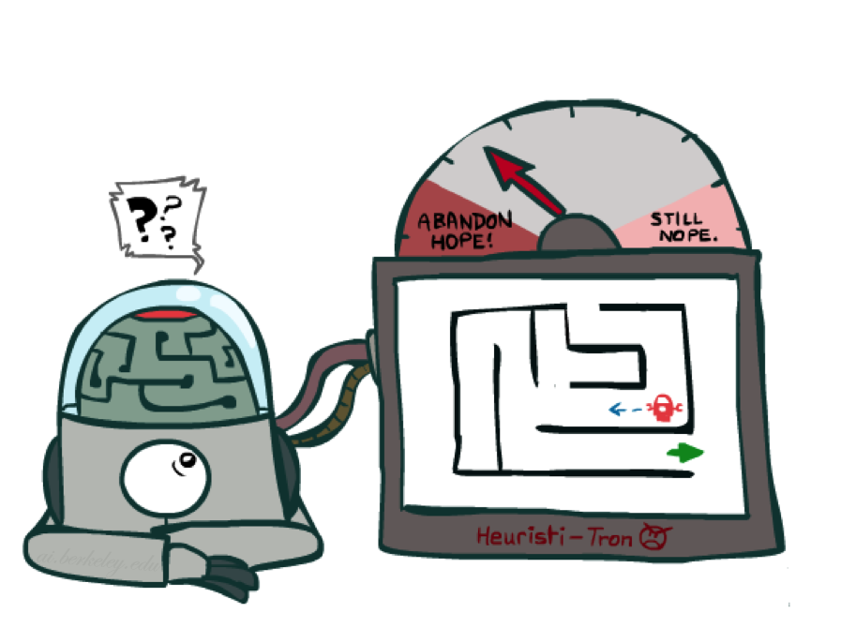
Idea: Admissibility
Inadmissible (pessimistic) heuristics break optimality by trapping good plans on the fringe
Admissible (optimistic) heuristics slow down bad plans but never outweigh true costs

Slide 21

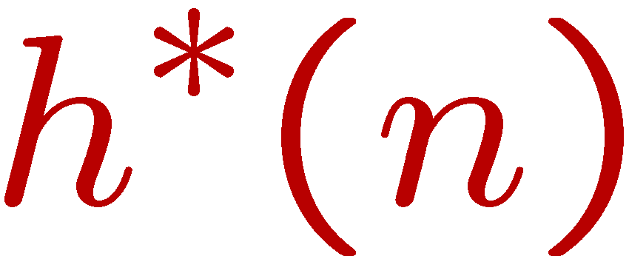
Admissible Heuristics
A heuristic h is admissible (optimistic) if:
where is the true cost to a nearest goal
Example:
Coming up with admissible heuristics is most of what’s involved in using A* in practice.
15

Slide 22

Creating Heuristics

Slide 23
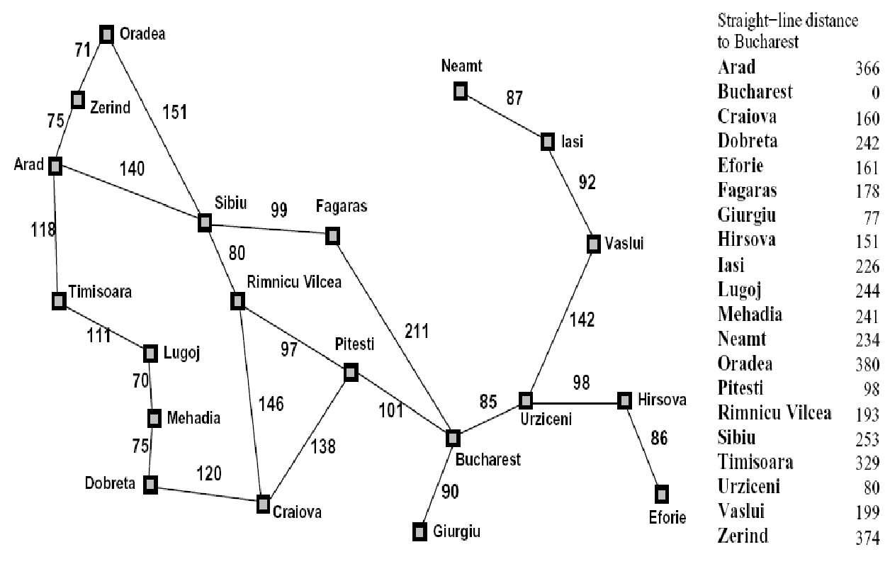
Creating Admissible Heuristics
Most of the work in solving hard search problems optimally is in coming up with admissible heuristics
Often, admissible heuristics are solutions to relaxed problems, where new actions are available
Inadmissible heuristics are often useful too
366
15

Slide 24
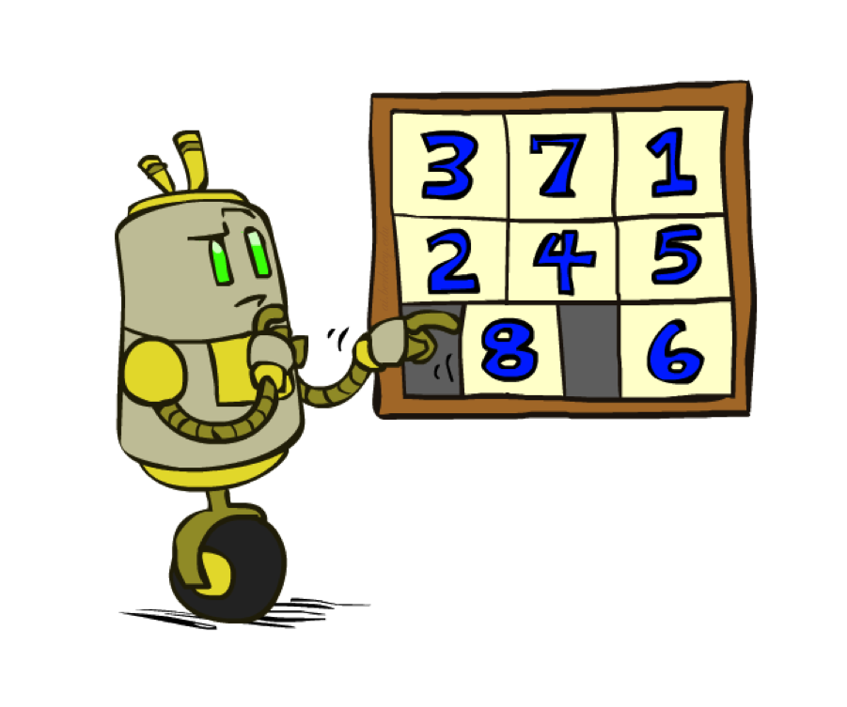
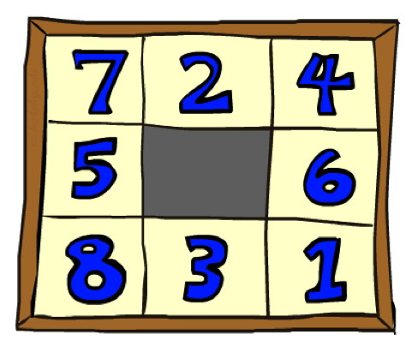
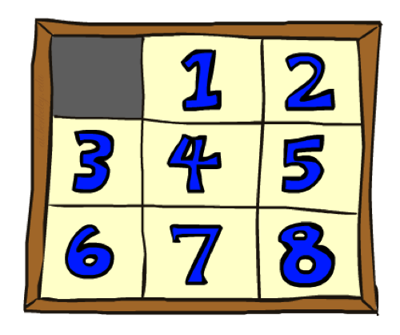
Example: 8 Puzzle
Start State
Actions
Goal State
What are the states?
How many states?
What are the actions?
How many successors from the start state?
What should the costs be?

Slide 25
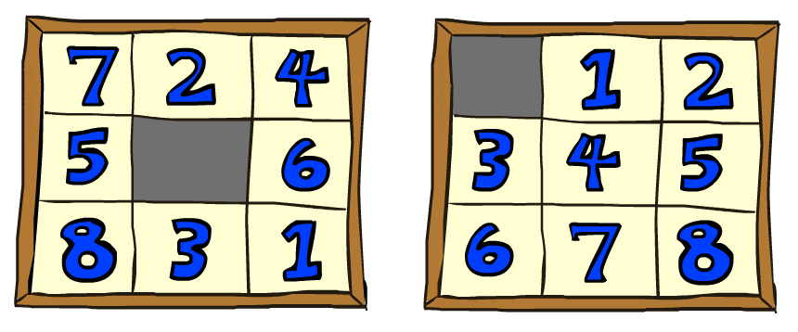
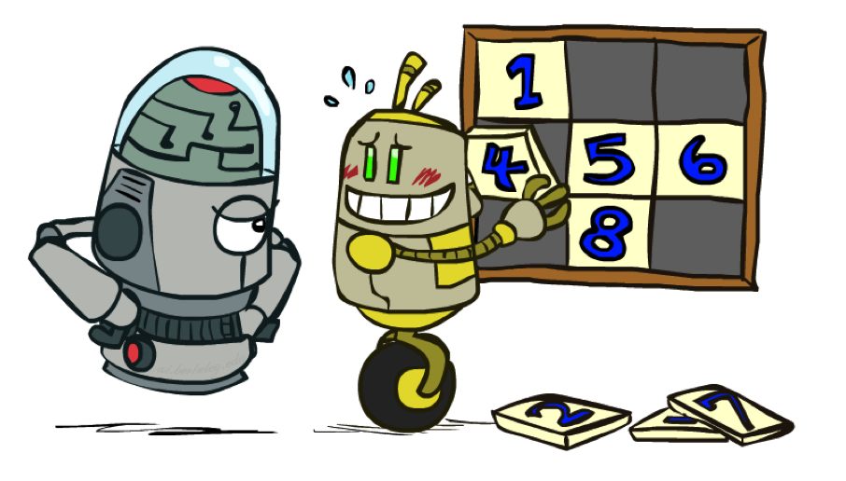
8 Puzzle I
Heuristic: Number of tiles misplaced
Why is it admissible?
h(start) =
This is a relaxed-problem heuristic
8
Start State
Goal State
 | Average nodes expanded when the optimal path has…
 | …4 steps | …8 steps | …12 steps
UCS | 112 | 6,300 | 3.6 x 10⁶
TILES | 13 | 39 | 227
Statistics from Andrew Moore

Slide 26
8 Puzzle II
What if we had an easier 8-puzzle where any tile could slide any direction at any time, ignoring other tiles?
Total Manhattan distance
Why is it admissible?
h(start) =
Start State
Goal State
 | Average nodes expanded when the optimal path has…
 | …4 steps | …8 steps | …12 steps
TILES | 13 | 39 | 227
MANHATTAN | 12 | 25 | 73
3 + 1 + 2 + … = 18

Slide 27
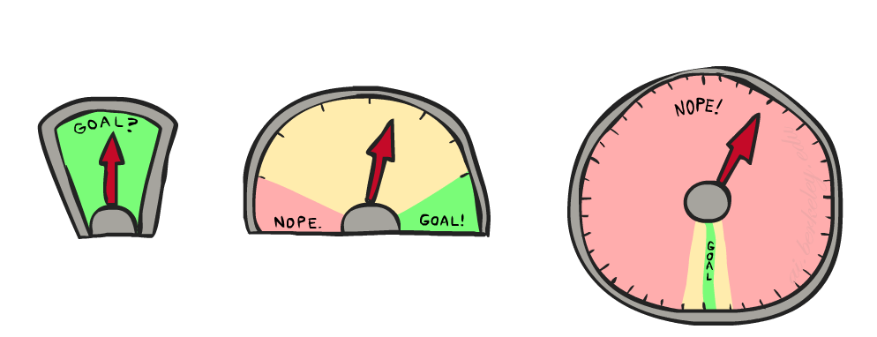
8 Puzzle III
How about using the actual cost as a heuristic?
  Would it be admissible?
  Would we save on nodes expanded?
  What’s wrong with it?
With A*: a trade-off between quality of estimate and work per node
  As heuristics get closer to the true cost, you will expand fewer nodes but usually do more work per node to compute the heuristic itself

Slide 28
Semi-Lattice of Heuristics

Slide 29







Trivial Heuristics, Dominance
Dominance: h_{a} ≥ h_{c} if
Heuristics form a semi-lattice:
  Max of admissible heuristics is admissible
Trivial heuristics
  Bottom of lattice is the zero heuristic (what does this give us?)
  Top of lattice is the exact heuristic
Notes:
Semi-lattice: x <= y <-> x = x ^ y

Slide 30
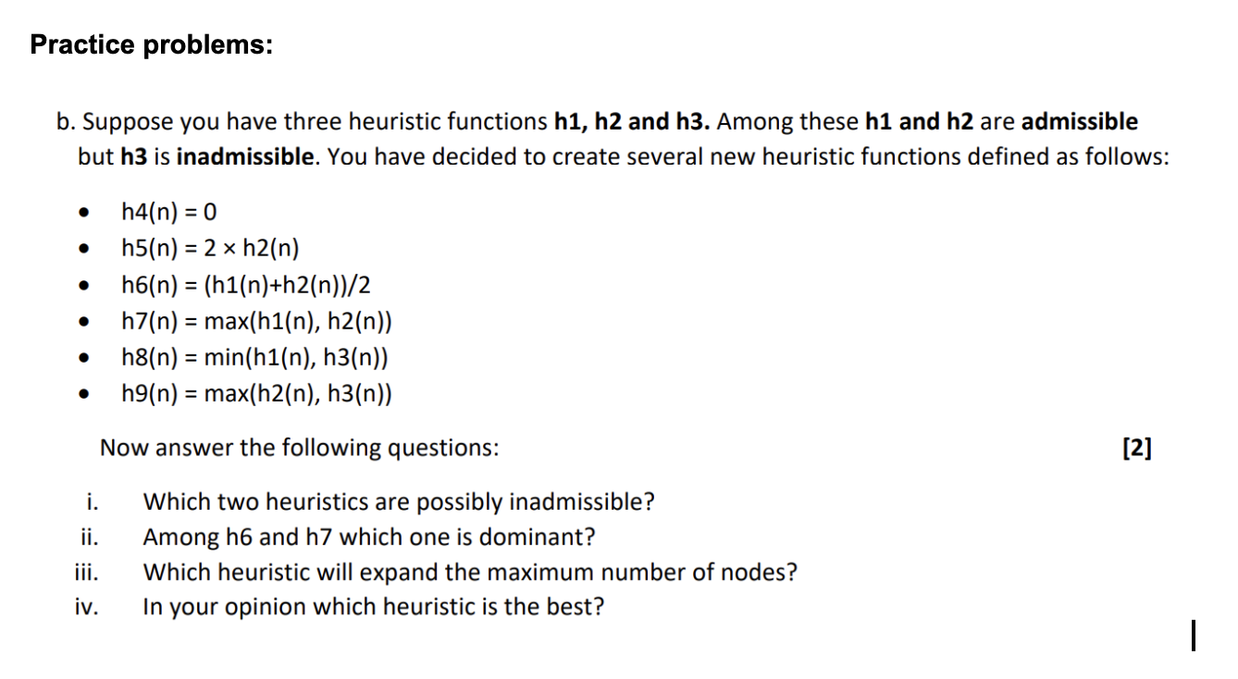

Slide 31
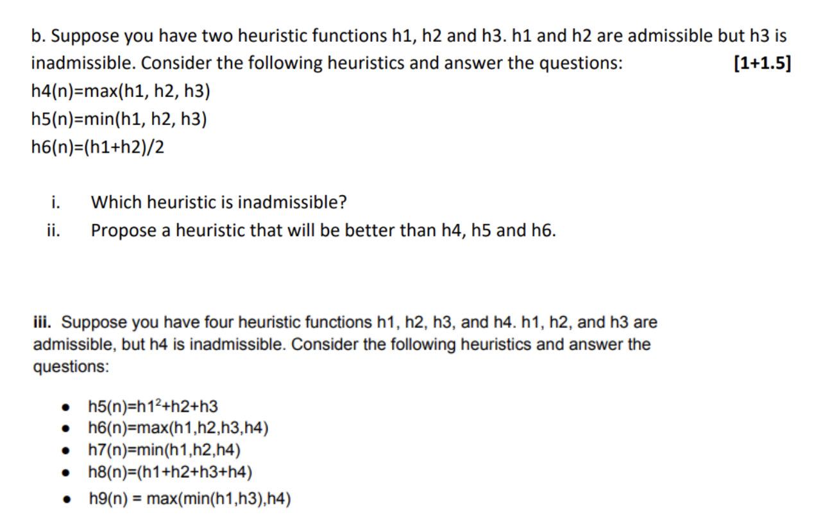

Slide 32
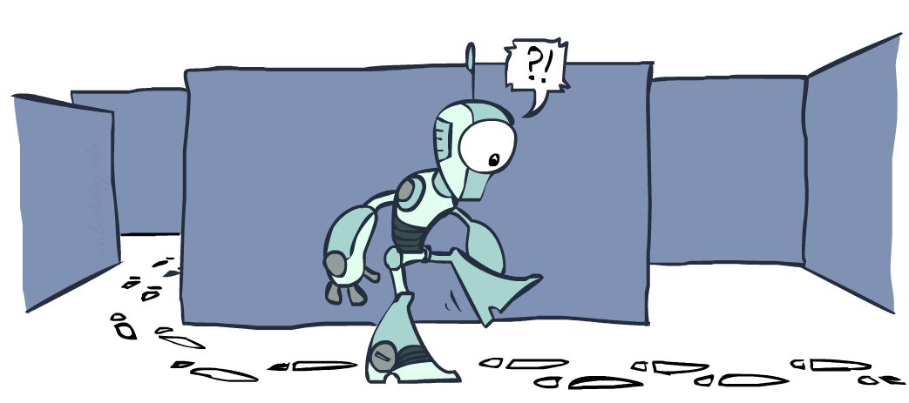
Graph Search

Slide 33
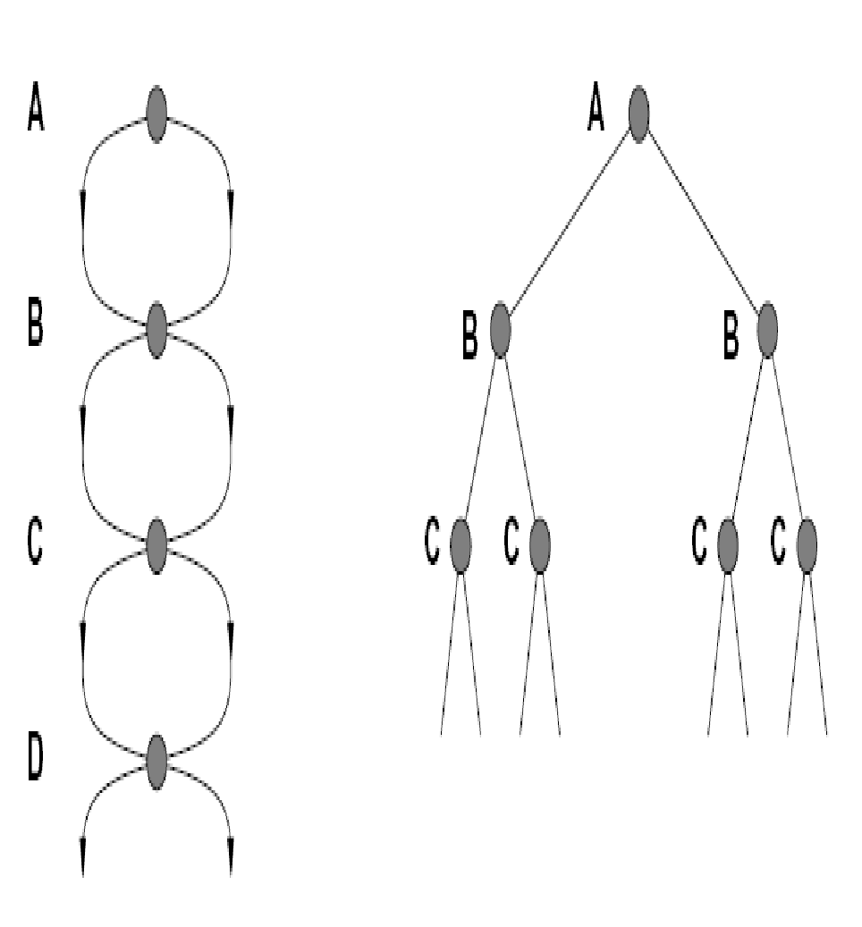

Tree Search: Extra Work!
Failure to detect repeated states can cause exponentially more work.
State Graph
Search Tree

Slide 34
Graph Search
In BFS, for example, we shouldn’t bother expanding the circled nodes (why?)
S
d
e
p
b
c
e
h
r
q
a
a
h
r
p
q
f
p
q
f
q
c
G
q
c
G
a
a

Slide 35
Graph Search
Idea: never expand a state twice
How to implement:
  Tree search + set of expanded states (“closed set”)
  Expand the search tree node-by-node, but…
  Before expanding a node, check to make sure its state has never been expanded before
  If not new, skip it, if new add to closed set
Important: store the closed set as a set, not a list
Can graph search wreck completeness? Why/why not?
How about optimality?

Slide 36
A* Graph Search Gone Wrong?
State space graph
Search tree
A
S (0+2)
1
S
1
C
h=4
h=1
A (1+4)
B (1+1)
h=2
1
2
B
3
C (2+1)
C (3+1)
h=1
G
G (5+0)
G (6+0)
h=0

Slide 37
Consistency of Heuristics
Main idea: estimated heuristic costs ≤ actual costs
  Admissibility: heuristic cost ≤ actual cost to goal
  h(A) ≤ actual cost from A to G
  Consistency: heuristic “arc” cost ≤ actual cost for each arc
  h(A) – h(C) ≤ cost(A to C)
Consequences of consistency:
  The f value along a path never decreases
  h(A) ≤ cost(A to C) + h(C)
  A* graph search is optimal
A
1
C
h=4
h=1
h=2
3
G

Slide 38

Optimality of A* Graph Search

Slide 39
Optimality of A* Graph Search
Sketch: consider what A* does with a consistent heuristic:
  Fact 1: In tree search, A* expands nodes in increasing total f value (f-contours)
  Fact 2: For every state s, nodes that reach s optimally are expanded before nodes that reach s suboptimally
  Result: A* graph search is optimal
…
f ≤ 1
f ≤ 2
f ≤ 3

Slide 40
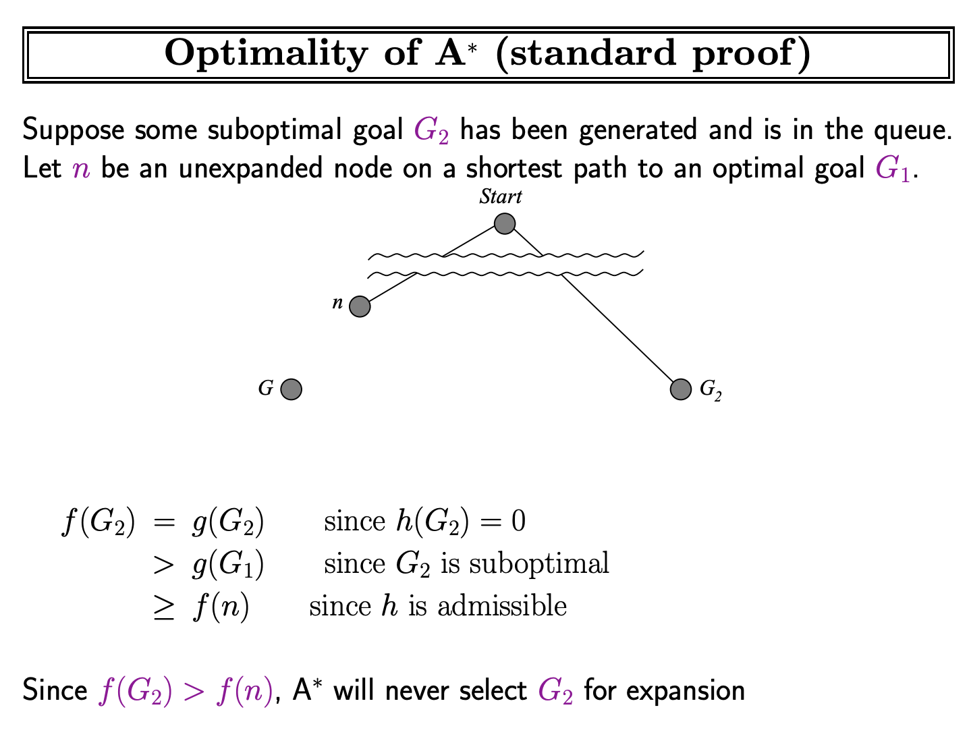

Slide 41
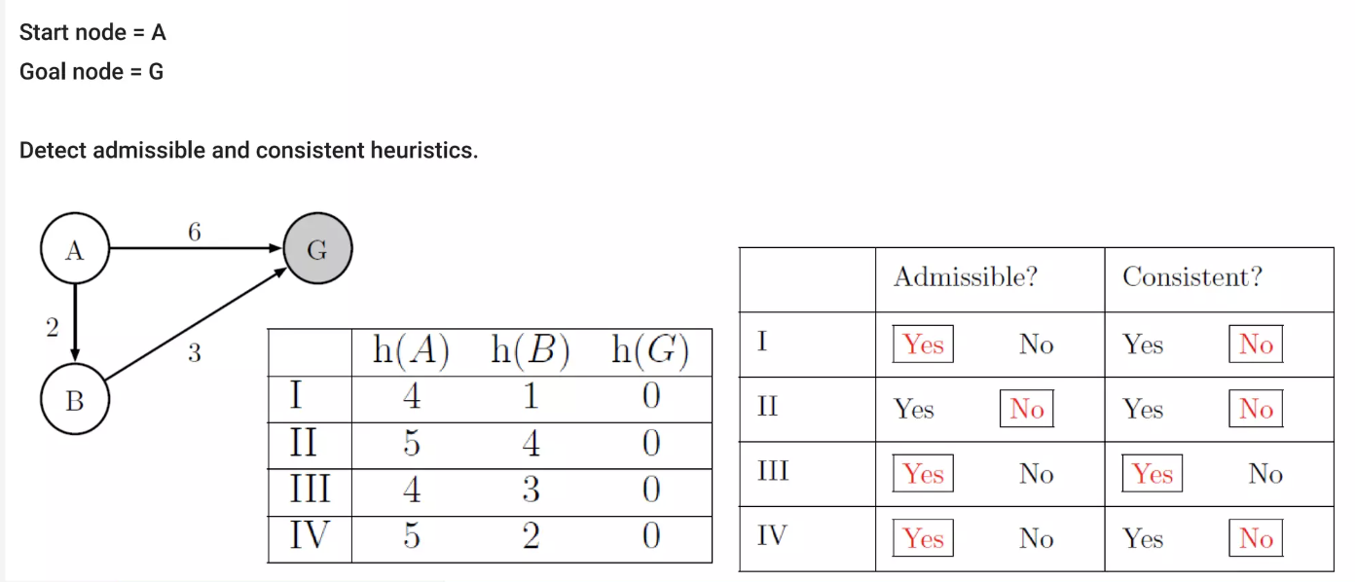
Heuristic Testing

Slide 42
Heuristic Testing

Slide 43
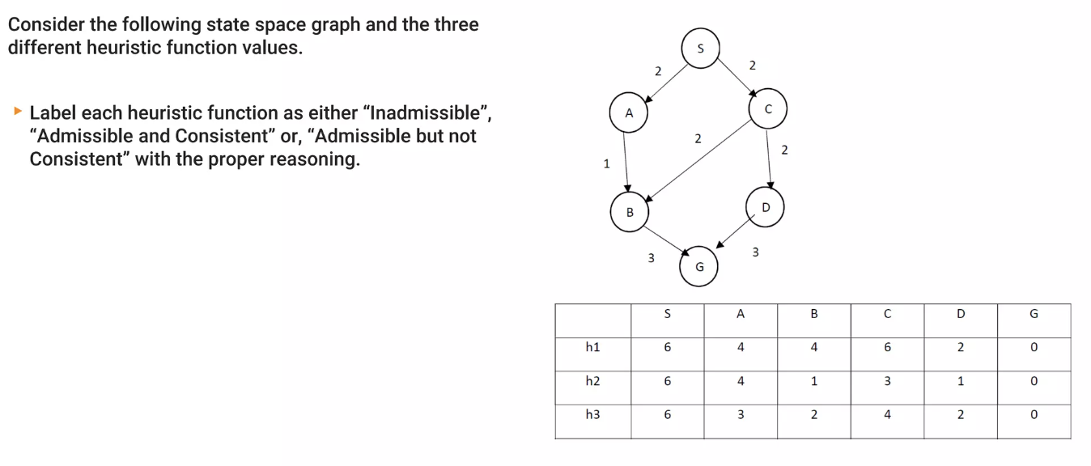
Heuristic Testing

Slide 44
Optimality
Tree search:
  A* is optimal if heuristic is admissible
  UCS is a special case (h = 0)
Graph search:
  A* optimal if heuristic is consistent
  UCS optimal (h = 0 is consistent)
Consistency implies admissibility
In general, most natural admissible heuristics tend to be consistent, especially if from relaxed problems

Slide 45

A*: Summary

Slide 46
A*: Summary
A* uses both backward costs and (estimates of) forward costs
A* is optimal with admissible / consistent heuristics
Heuristic design is key: often use relaxed problems

Slide 47
Memory Bounded Informed Search
IDA* (Iterative Deepening A)*: Combines depth-first search with the heuristic evaluation of A*. Uses cost thresholds (f-values) to prune paths, running multiple depth-first iterations to save space at the cost of re-generating some nodes.
SMA* (Simplified Memory-Bounded A)*: Operates like A* until available memory is completely full. When capacity is reached, it drops or prunes the worst node (highest f-cost) while backing up its value to parent nodes, balancing optimality and memory constraints.
RBFS (Recursive Best-First Search): Mimics standard best-first search using a recursive depth-first approach. It keeps track of the backup value of the best alternative path available from any ancestor, using very little memory.

Slide 48
IDA* Algorithm
What is the Iterative Deepening A* (IDA*) Algorithm?
IDA* is a variant of depth-first search (DFS) that iteratively deepens its search by incrementing the cost threshold, which controls the depth of the exploration. Unlike A*, which explores all possible nodes within a threshold, IDA* uses a heuristic function to evaluate and prioritize the most promising nodes. This allows it to prune less promising paths, reducing memory usage while ensuring that the search focuses on optimal routes.
Key Features of IDA* Algorithm
Graph Traversal Algorithm: IDA* explores a graph by progressively deepening the search depth.
Shortest Pathfinding: It efficiently finds the shortest path in a weighted graph using a combination of DFS and A* techniques.
Admissible Heuristic: The heuristic function in IDA* ensures that the estimated cost never exceeds the actual cost, making it an admissible heuristic.
Memory Efficiency: As a depth-first search algorithm, IDA* uses far less memory compared to the traditional A* algorithm.
Focused Search: The algorithm is designed to explore only the most promising nodes, ensuring it doesn’t go to unnecessary depths.

Slide 49
IDA* Algorithm
How the IDA* Algorithm Works?
The IDA* algorithm works by incrementally increasing the threshold based on the f-score of each node, which is calculated using the formula:
f(n)=g(n)+h(n)
f(n)=Actual cost+Estimated cost
Where h is admissible.
Step-by-Step Process of the IDA* Algorithm
Initialization: Set the root node as the current node and compute its f-score.
Set Threshold: Initialize a threshold based on the f-score of the starting node.
Node Expansion: Expand the current node’s children and calculate their f-scores.
Pruning: If the f-score exceeds the threshold, prune the node and store it for future exploration.
Path Return: Once the goal node is found, return the path from the start node to the goal.
Update Threshold: If the goal is not found, increase the threshold based on the minimum pruned value and repeat the process.

Slide 50
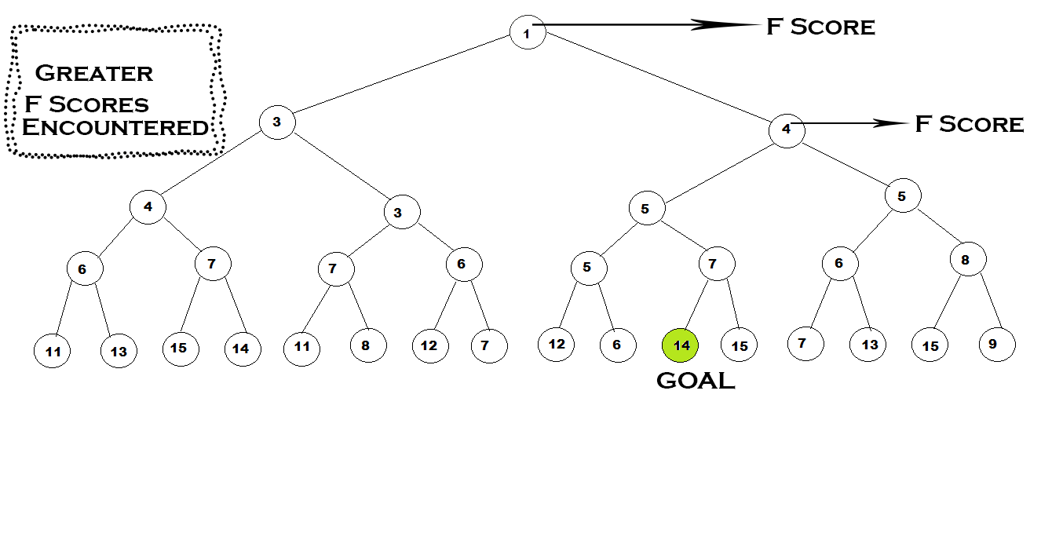
IDA* Algorithm
Example of IDA* Algorithm
In the below tree, the f score is written inside the nodes means the f score is already computed and the start node is 1 whereas the goal node is 14.
So now we have to go to a given goal by using IDA* algorithm.
https://algorithmsinsight.wordpress.com/graph-theory-2/ida-star-algorithm-in-general/

Slide 51
SMA* ( Simplified Memory Bounded A*)
SMA* ( Simplified Memory Bounded A*) is a shortest path algorithm that is based on the A* algorithm. The difference between SMA* and A* is that SMA* uses a bounded memory, while the A* algorithm might need exponential memory.
Like the A*, it expands the most promising branches according to the heuristic. What sets SMA* apart is that it prunes nodes whose expansion has revealed less promising than expected.
SMA*, just like A* evaluates nodes by combining g(n) and h(n): f(n) = g(n) + h(n).

Slide 52
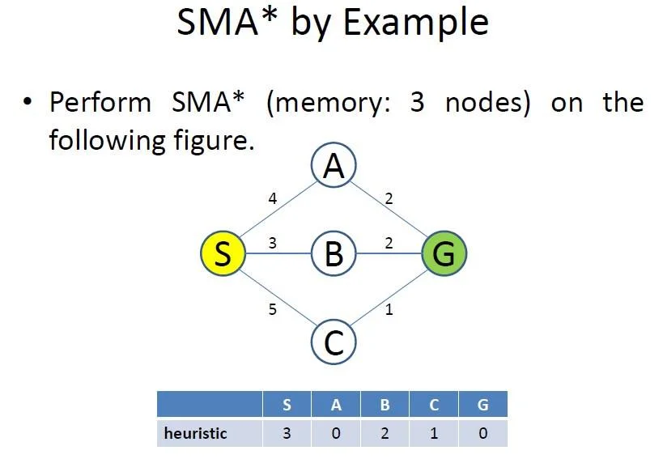
SMA* ( Simplified Memory Bounded A*)

Slide 53
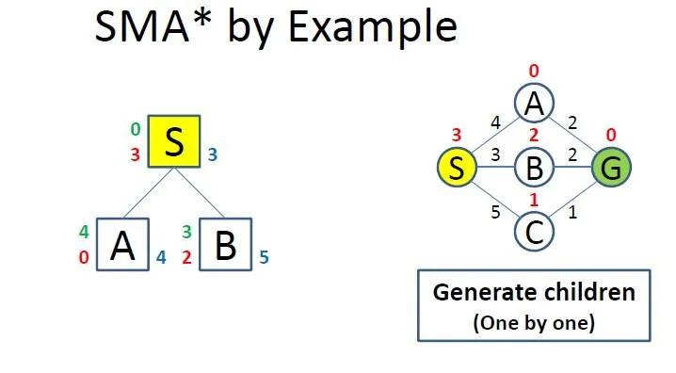
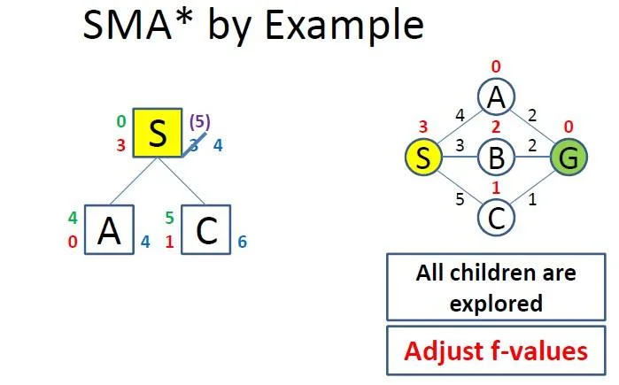
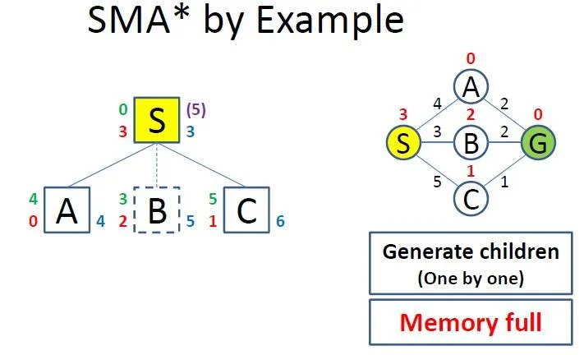
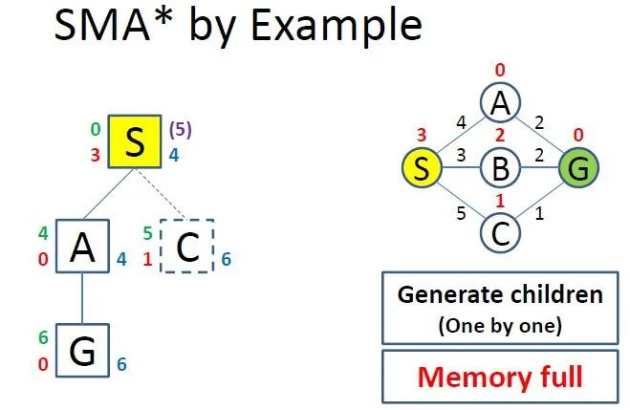
SMA* ( Simplified Memory Bounded A*)
step 1
step 3
step 2
step 4

Slide 54
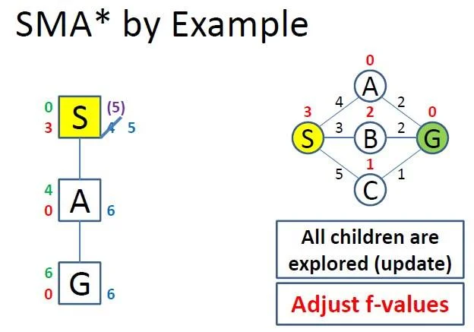
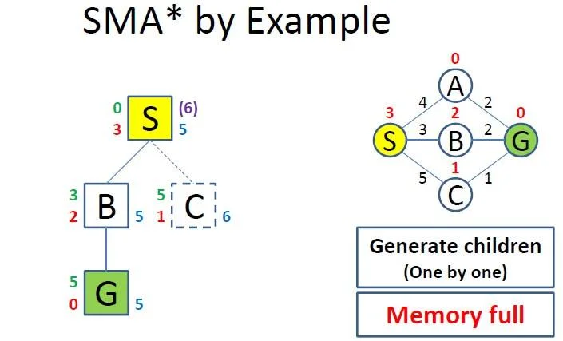
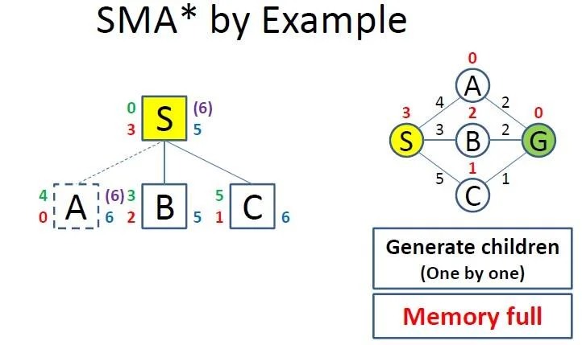
SMA* ( Simplified Memory Bounded A*)
step 5
step 7
step 6
Ref: https://laconicml.com/simplified-memory-bounded-a-star/

Slide 55
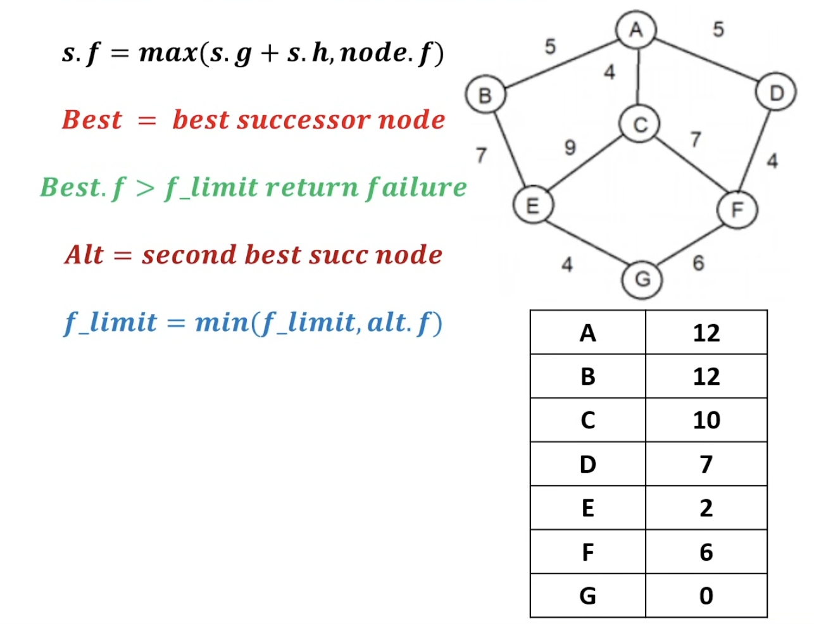
RBFS (recursive best-first search)

Slide 56
1
Expand A — Generate Its Children
Best: D (f=12)
Alt: C (f=14)
f_limit: 14
A
f=12
BEST
ALT
D
C
B
f=12
f=14
f=17
A has three children: B (17), C (14), D (12). D has the lowest f, so it becomes Best — RBFS recurses into D first, capping the search at f_limit = 14 (C’s value).

Slide 57
2
Expand D → F — Limit Exceeded, Back Up
Best: F (f=15)
Alt: —
f_limit: 14
Best.f (15) > f_limit (14) → FAIL
A
f=12
D
C
B
f=12 15
f=14
f=17
F
f=15
D's only child is F, with f = max(9+6, 12) = 15. That's above the limit (14), so RBFS gives up on this branch and backs up: D's f is updated from 12 to 15.

Slide 58
3
Backtrack to A → Try C → Generate E, F
Best: E (f=15)
Alt: F (f=17)
f_limit: 15
A
f=12
D
C
B
f=15
f=14
f=17
BEST
ALT
F
E
F
f=15
f=15
f=17
Back at A, C (14) is now the best child — cheaper than D's updated 15. Expanding C generates E (15) and F (17); E becomes the new Best, with f_limit tightened to 15.

Slide 59
4
Expand E → G — Fails, Then C Fails Too
Best: G (f=17)
Alt: —
f_limit: 15
Both E and F now exceed f_limit → C FAILS
A
f=12
D
C
B
f=15
f=14 17
f=17
F
E
F
f=15
f=15 17
f=17
G
f=17
E's child G has f = max(13+4, 15) = 17, over the limit — E backs up to 17. Now both of C's children (E=17, F=17) exceed f_limit(15), so C itself fails and updates to 17.

Slide 60
5
Back to D → F → G — Goal Reached!
Best: D (f=15)
Alt: C (f=17)
f_limit: 17
G is the goal, f=15 ≤ f_limit → SUCCESS!
A
f=12
D
C
B
f=15
f=17
f=17
F
E
F
f=15
f=17
f=17
G
G
f=15
f=17
D (15) beats C (17), so RBFS re-expands D → F (15, already known) → G. G's f = 15 is within the limit (17) and G is the goal — the search succeeds along A → D → F → G.

Slide 61
Final Result
The complete search tree, and the path RBFS returns
A
f=12
D
C
B
f=15
f=17
f=17
F
E
F
f=15
f=17
f=17
G
G
f=15
f=17
Path: A → D → F → G Cost: 5 + 4 + 6 = 15 (optimal — cheaper than A-C-E-G = 17 and A-B-E-G = 16)

